Slide 1

Lifestyle Store
Detailed Developer Report

Slide 2
Security Status – Extremely Vulnerable
Hacker can steal all records in Internshal databases (SQLi)
Hacker can take control of complete server including View, Add, Edit, Delete files and folders (Shell Upload)
Hacker can change the entire content of the website(Gaining Admin Control)
Hacker can inject client side code into applications and trick users by changing how page looks to steal information or spoil the name of Internshala (XSS)
Hacker can extract mobile number,address,username and more details of all customers (IDOR)
Hacker can inject any set of codes and check the server and its content(Command Execution)

Slide 3
Vulnerability Statistics
Critical
5
Severe
18
Moderate
5
Low
6

Slide 4
Vulnerabilities:
No | Severity | Vulnerability | Count
1 | Critical | SQL Injection | 1
2 | Critical | Insecure File Uploads | 1
3 | Critical | File Inclusion Vulnerabilities | 1
4 | Critical | Forced Browsing | 1
5 | Critical | Command Execution | 1
6 | Severe | Cross site scripting | 3
7 | Severe | Cross site request forgery | 2
8 | Severe | Rate Limiting Flaws | 5
9 | Severe | Crypto Configuration Flaw | 1
10 | Severe | Weak Password | 2
11 | Severe | Open Redirection | 1
12 | Severe | Bruteforce Exploitation | 2

Slide 5
13 | Severe | Components with known Vulnerabilities | 1
14 | Moderate | Directory Listing | 1
15 | Moderate | IDOR | 2
16 | Moderate | PII | 2
17 | Low | Client Side Filter Bypass | 3
18 | Low | Descriptive Messages | 2
19 | Low | Descriptive Pages | 1

Slide 6
1. SQL Injection
SQL Injection (Critical) | Below mentioned URL is vulnerable to SQL injection attack Affected URL : http://13.233.207.87/search/search.php?q=plain Affected Parameters : q (GET parameter) Payload: q=plain' or 1=1--+

Slide 7
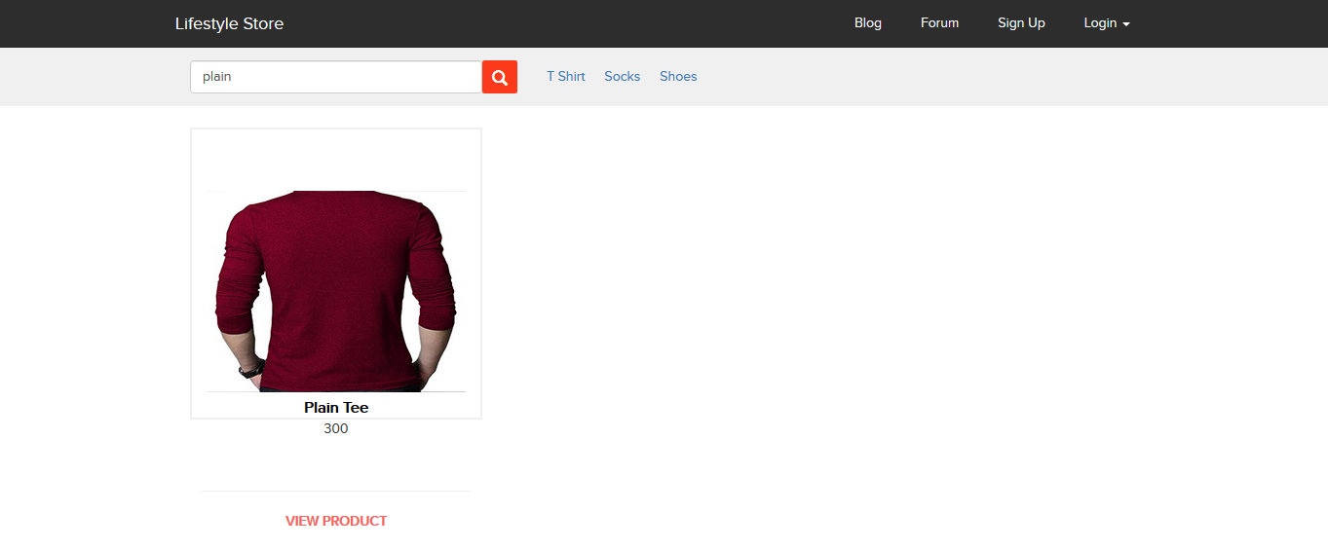
Observation
Clicking on shop now button,we get a search option on the top left corner,where we can search for anything on the website,as-

Slide 8
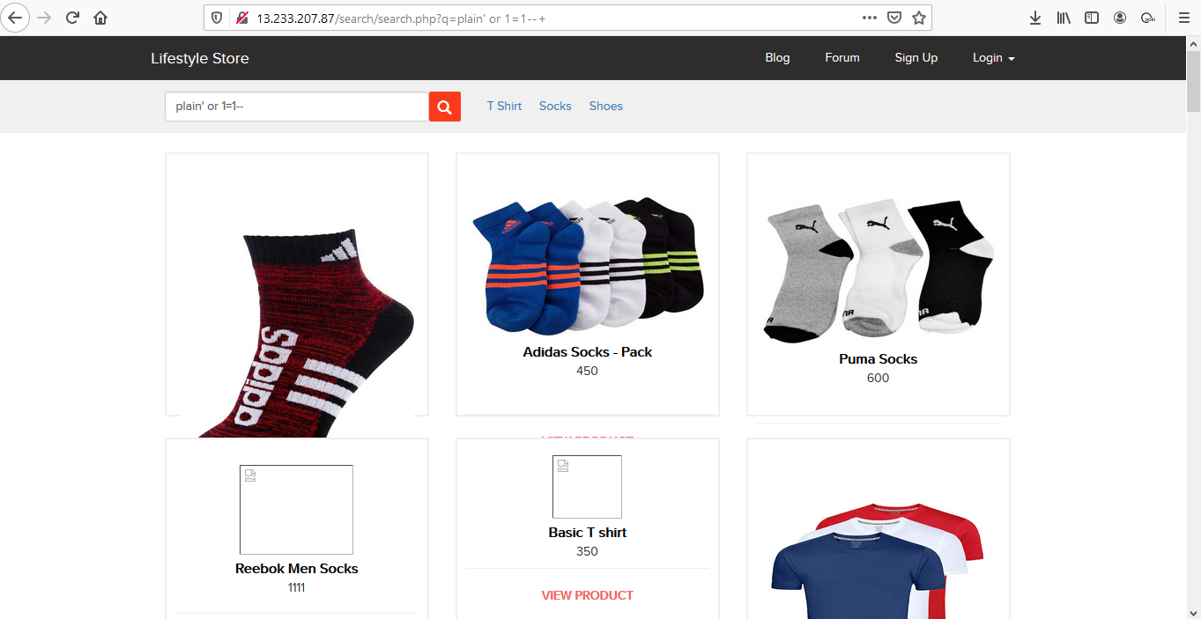
Observation
We apply single quote at the end of q parameter and we get complete MySQL error:
Also,we can the try q=plain'or 1=1--+ in the url and the result confirmed sql injection.

Slide 9

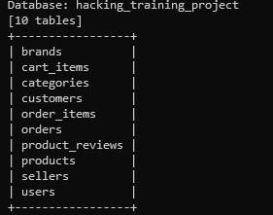
POC using SQL-map

Slide 10
PoC – Attacker can dump arbitrary data
No of databases: 2
information_schema
hacking_training_project
No of tables in SQL_Injection_V3: 10
Brands
cart_items
categories
customers
order_items
orders
product_reviews
products
sellers
users

Slide 11
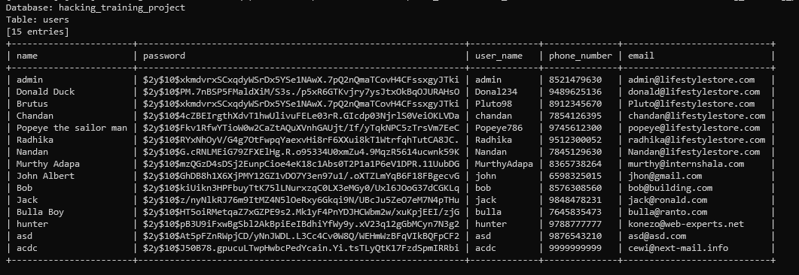
Business Impact – High
Using this vulnerability, attacker can execute arbitrary SQL commands on Internshala server and gain complete access to internal databases along with all customer data inside it.
Alongside is the screenshot of users table which shows user credentials being leaked ,although with hashing,dictionary-based and logic-based bruteforcing passwords still remains an option to verify with.

Slide 12
Recommendation
Take the following precautions to avoid exploitation of SQL injections:
Whitelist User Input: Whitelist all user input for expected data only. For example if you are expecting a flower name, limit it to alphabets only upto 20 characters in length. If you are expecting some ID, restrict it to numbers only
Prepared Statements: Use SQL prepared statements available in all web development languages and frameworks to avoid attacker being able to modify SQL query
Character encoding: If you are taking input that requires you to accept special characters, encode it. Example. Convert all ‘ to \’ , “ to \”, \ to \\. It is also suggested to follow a standard encoding for all special characters such has HTML encoding, URL encoding etc
Do not store passwords in plain text. Convert them to hashes using SHA1 SHA256 Blowfish etc
Do not run Database Service as admin/root user
Disable/remove default accounts, passwords and databases
Assign each Database user only the required permissions and not all permissions

Slide 13
References
https://www.owasp.org/index.php/SQL_Injection
https://en.wikipedia.org/wiki/SQL_injection

Slide 14
2. Insecure File Uploads
Insecure File Uploads (Critical) | Below mentioned URL is vulnerable to Insecure File Upload Affected URL : http://13.233.207.87/wondercms/ File Uploaded: 1.Sample php file 2.B374kmini.php(php shell)

Slide 15
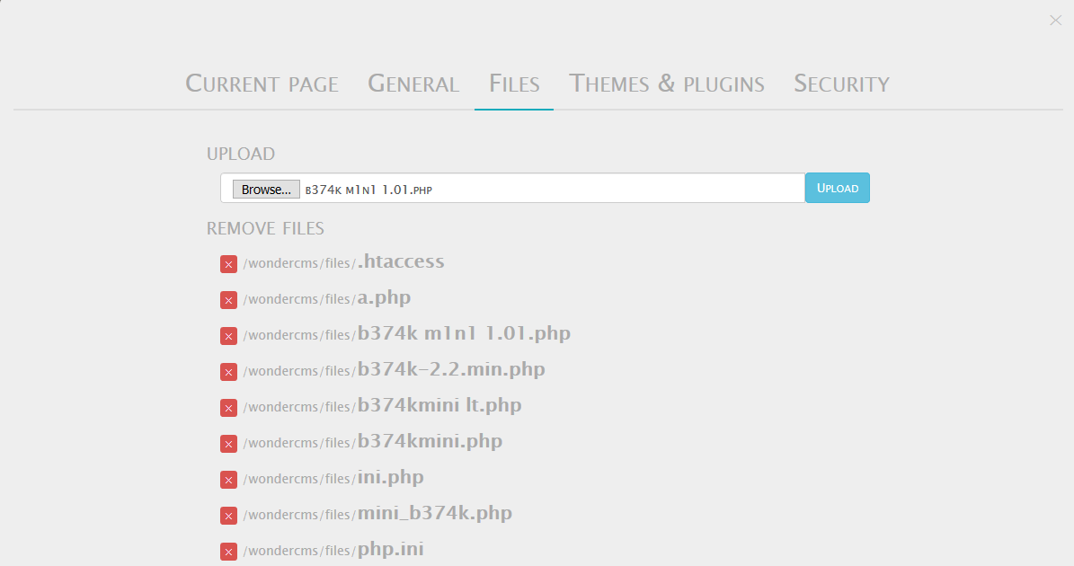
Observation:
When we click on blog option, and login to the admin panel using password admin, we see file upload option in settings,where we can upload any kind of file.

Slide 16
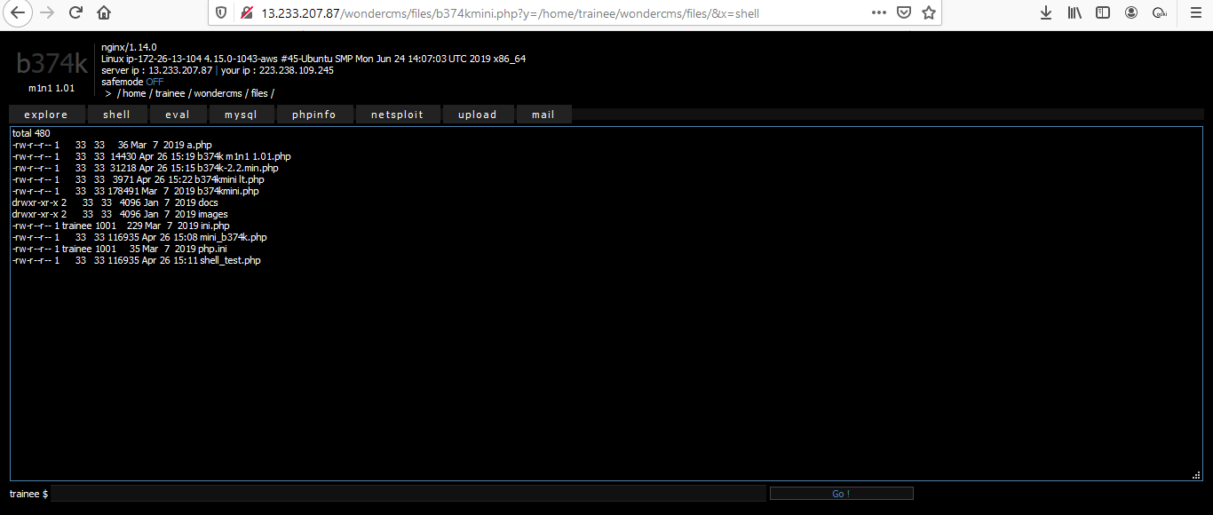
Proof of Concept(PoC):
When we click on the mini shell which we uploaded,we get the acces to directories by typing commands in the shell option and much more .

Slide 17
Business Impact(High):
Using this vulnerability,the attacker can get the complete control of the system, database and can also forward attacks in the back-end systems along with client-side attacks or simple defacement.
The impact of this vulnerability is high, supposed code can be executed in the server context or on the client side. A malicious file such as a Unix shell script, a windows virus, an Excel file with a dangerous formula, or a reverse shell can be uploaded on the server in order to execute code by an administrator or webmaster later -- on the victim's machine.
An attacker might be able to put a phishing page into the website or deface the website and much more.

Slide 18
Recommendations:
Blacklisting File Extensions like .php,.php5,.shtml,etc
Whitelist the file extensions like .jpg,.pdf,etc
Content type header validation
Using File type detector
Perform proper server-side validations on what kind of a file user is uploading
Use white lists filters instead of black list filters. Example: in case of a resume upload feature, instead of banning PHP and .exe files, only allow .pdf, .doc and .docx files
Rename the files using a code, so that the attacker cannot play around with file names
Use static file hosting servers like CDNs and File Clouds to store files instead of storing them on the application server itself

Slide 19
References:
https://www.owasp.org/index.php/Unrestricted_File_Upload
https://www.opswat.com/blog/file-upload-protection-best-practices

Slide 20
3. File Inclusion Vulnerabilities
File Inclusion Vulnerabilities (Critical) | Below mentioned URL is vulnerable to File Inclusion Vulnerabilities Affected URL : http://35.154.118.58

Slide 21
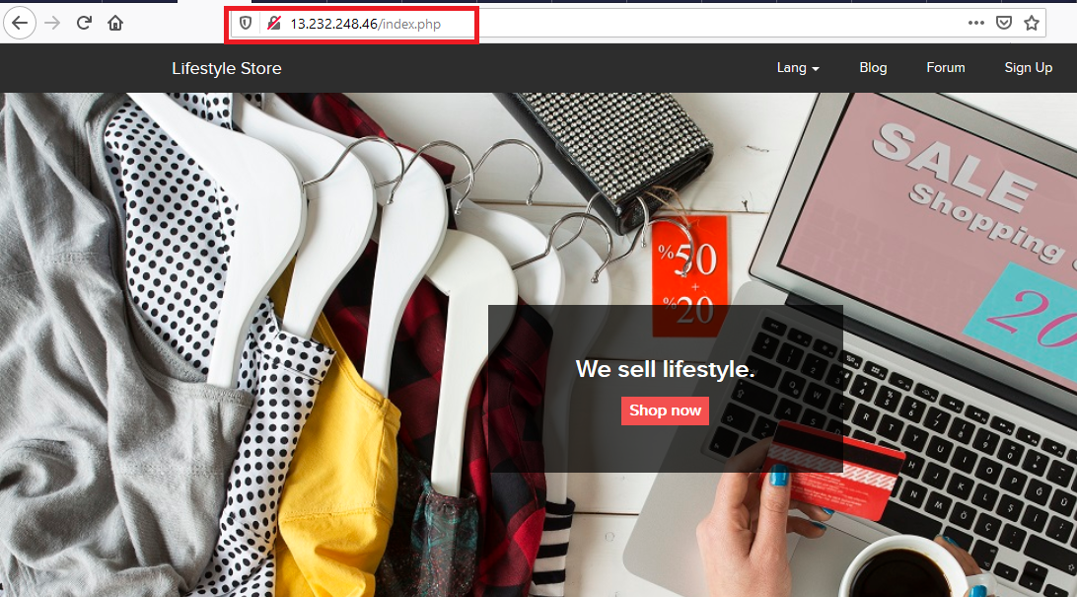
Observation:
Check if the index.php file exists in the URL. ie. http://13.232.248.46/index.php.

Slide 22
Proof Of Concept(PoC):
Change the url to "http://13.232.248.46/?includelang=http://13.232.248.46/wondercms/files/b374kmini.php". We get the acces to directories by typing commands in the shell option and much more .

Slide 23
Business Impact(Extremely High):
Using this vulnerability,the attacker can get the complete control of the system, database and can also forward attacks in the back-end systems along with client-side attacks or simple defacement.
The impact of this vulnerability is high, supposed code can be executed in the server context or on the client side. A malicious file such as a Unix shell script, a windows virus, an Excel file with a dangerous formula, or a reverse shell can be uploaded on the server in order to execute code by an administrator or webmaster later -- on the victim's machine.
An attacker might be able to put a phishing page into the website or deface the website and much more.

Slide 24
Recommendation:
Use a whitelist of filenames and ignore every other filename and path.
Instead of including files on the web server, store their content in databases where possible.
Removing or blacklisting character sequences. There are known bypasses for removing or blacklisting those.

Slide 25
References:
https://www.owasp.org/index.php/Unrestricted_File_Upload
https://www.opswat.com/blog/file-upload-protection-best-practices

Slide 26
4. Forced Browsing Flaws
Forced Browsing Flaws (Critical) | Access to admin dashboard after login into customer account Affected URL : http://35.154.249.93/profile/16/edit/ Payload : Change the url to "http://35.154.249.93/admin31/dashboard.php"

Slide 27
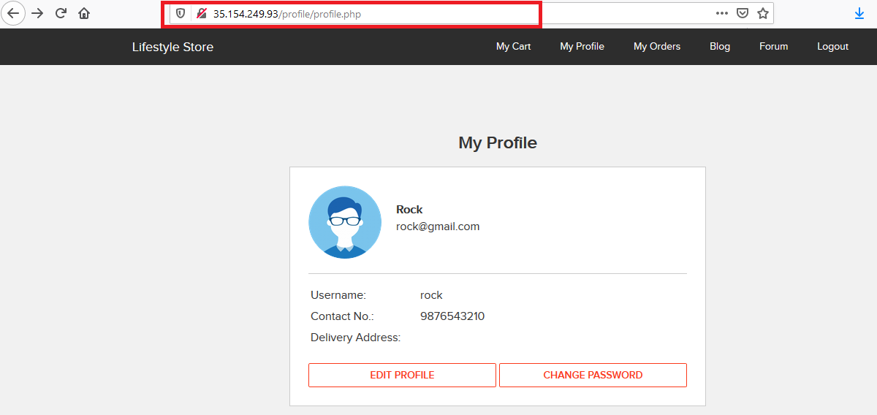
Observation:
Login into customer account

Slide 28
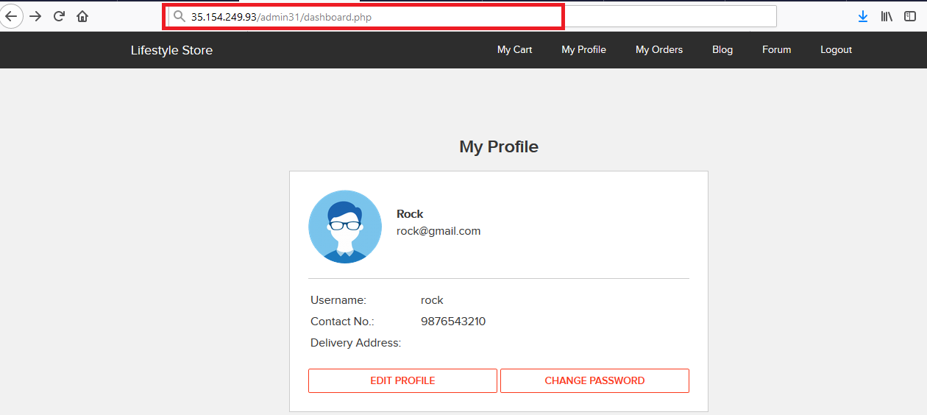
Observation:
Change the url to "http://35.154.249.93/admin31/dashboard.php"

Slide 29
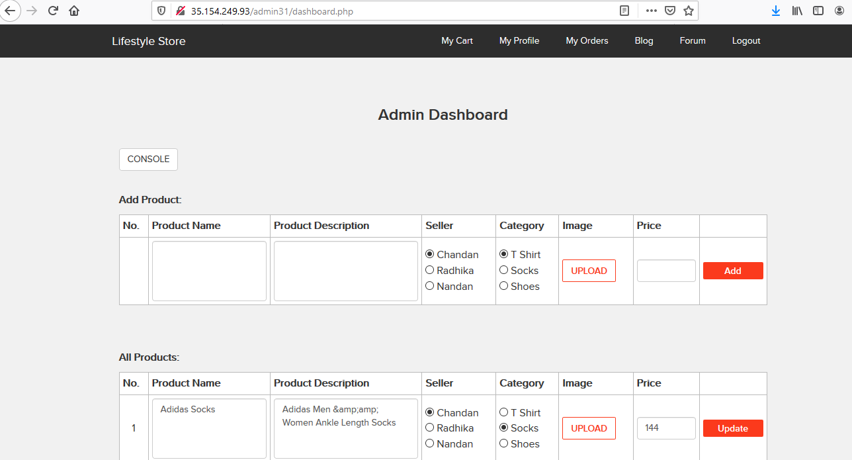
Proof Of Concept(PoC):
Malicious hacker can access the admin dashboard page, he can then add, update product.

Slide 30
Business Impact:Extremely High
After logging in as admin,the attacker gets almost all the control of the website business.
Right from changing the product, product details, Seller, Category etc..They can even change the product image, this may have a great business impact and hamper the privacy too.
Also ,changing cost of products can cause severe financial loss to the owner .

Slide 31
Recommendation:
There are two ways to protect against forced browsing – enforcing an application URL space allow list and using proper access control.
Creating an allow list (or whitelist) involves allowing explicit access to a set of URLs that are considered to be a part of the application to exercise its functionality as intended. Any request not in this URL space is denied by default. Manually creating and maintaining such a list can be tedious. You can use the Barracuda Web Application Firewall’s adaptive profiling to automatically create such a list and enforce it by learning the valid URL space from trusted traffic. It also comes with a block list of common files and directories that are commonly left exposed unintentionally.
In the second method, using proper access control and authorization policies, access is only given to users commensurate with their privileges. The Barracuda Web Application Firewall provides authorization policies at a URL level along with protection against session-based attacks to provide proper access control enforcement against such abuse
References:
1. https://hackingheart.wordpress.com/2012/07/03/forced-browsing-attack/
2. https://seclists.org/webappsec/2006/q3/182
3. http://projects.webappsec.org/w/page/13246953/Predictable%20Resource%20Location
4. https://cwe.mitre.org/data/definitions/425.html

Slide 32
5. Command Execution Vulnerability:
Command Execution Vulnerability (Critical) | Below mentioned URLs is vulnerable to Command Execution Affected URL : http://13.232.110.198/admin31/console.php

Slide 33
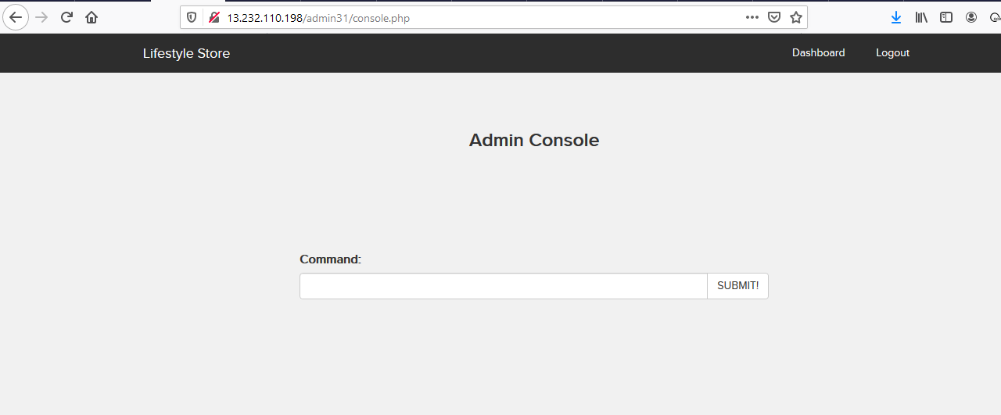
Observation:
After logging in as admin,when we navigated to the url 'http://13.232.110.198/admin31/console.php',we got the command line page where we can execute any command.

Slide 34
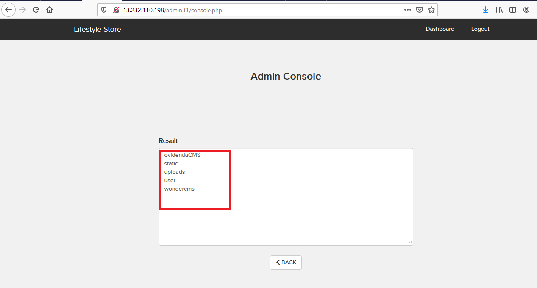
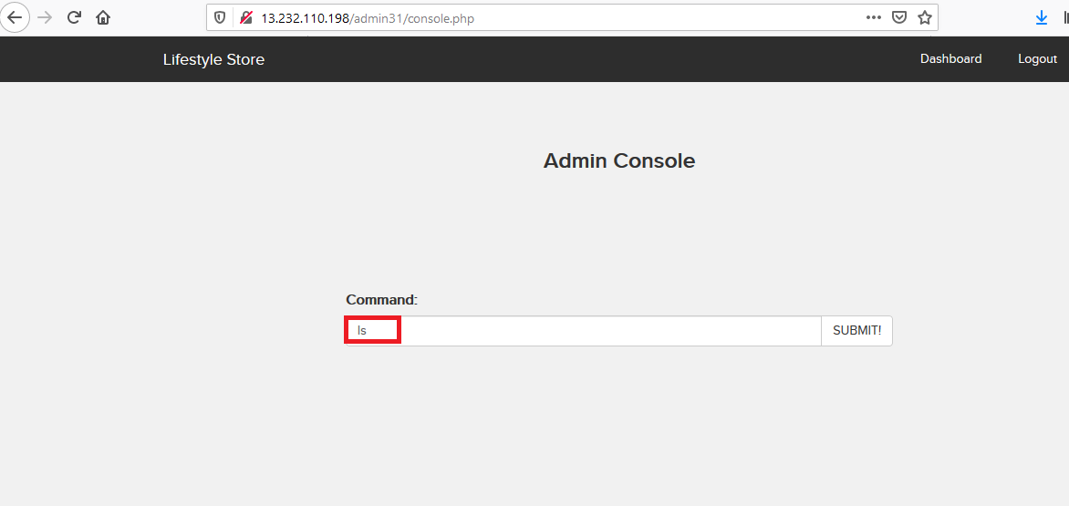
Proof Of Concept(PoC):
When we typed ls ,the result was as follows:

Slide 35
Business Impact(High):
If the attcker enters into the admin account and finally to the console url,the he can put in any malicious code to extract or even edit data,as he the has the admin priviledges.
Other than entering malicious code and stuffs, the attacker can even get the details of the websites and its components like its version and hence find vulnerabilities to exploit them.
If successfully exploited, impact could cover loss of confidentiality, loss of integrity, loss of availability, and/or loss of accountability.

Slide 36
Recommendations:
1)There should be filters so that malicious code cannot be injected in .
2)Input validation can be done.
3)Output Validation can be done.
4)Canonicalization can also be done.
References:
1)https://www.owasp.org/index.php/Command_Injection
2)https://www.owasp.org/index.php/Code_Injection

Slide 37
6. Cross Site Scripting(XSS):
Cross Site Scripting (Severe) | Below mentioned parameters are vulnerable to XSS Affected URL : http://35.154.249.93/products/details.php?p_id=34 Affected Parameters : comment(POST parameters) Payload: <script>alert(1);</script>

Slide 38
Cross Site Scripting (Severe) | Similar issue is found on below modules too Affected URL : http://35.154.249.93/profile/16/edit/ Affected Parameters : address(POST ) Payload: <script>alert(1);</script>
 | Affected URL : http://35.154.249.93/wondercms/ Affected Parameters : title(POST),and all the below it. Payload: <script>alert(1);</script>

Slide 39
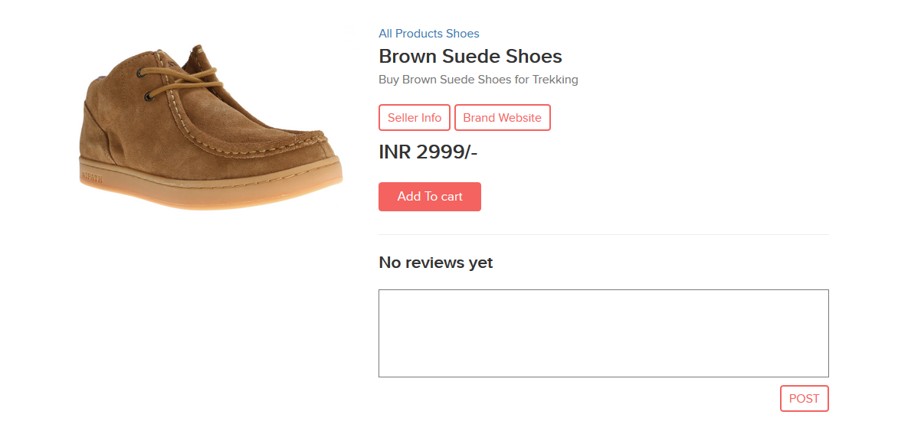
Observation:
When we navigate to 'http://35.154.249.93/products/details.php?p_id=34', we will see a review section below.

Slide 40
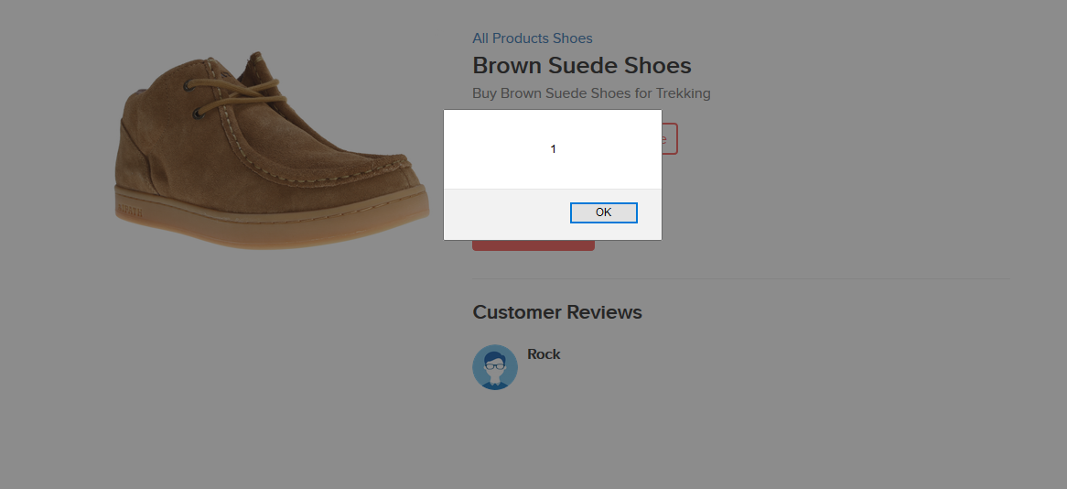
Proof Of Concept(PoC):
When we enter <script>alert(1);</script> and post it, we get this alert whenever we navigate to this page:

Slide 41
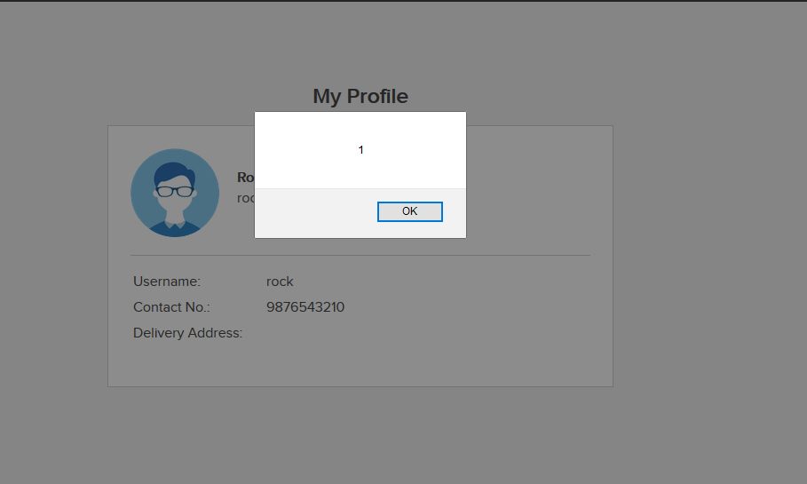
Proof Of Concept(Poc):
When we enter the same payload in the address portion and update it in the url - 'http://35.154.249.93/profile/16/edit/' ,we get:

Slide 42
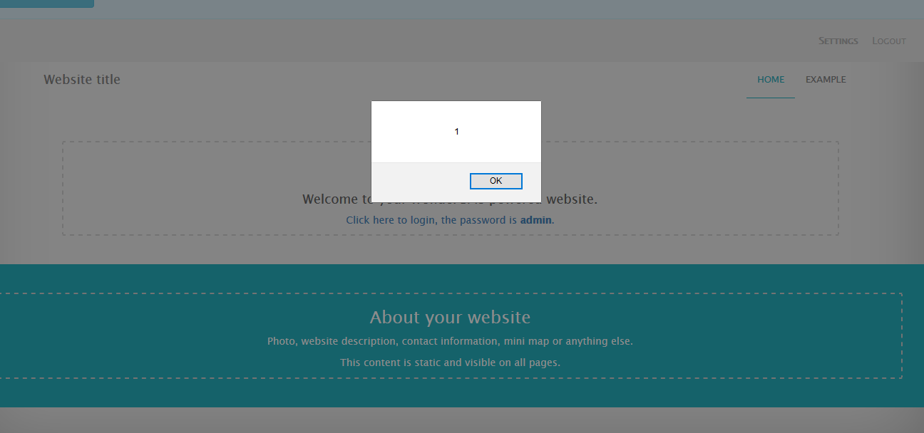
Proof Of Concept(PoC):
When we add the same payload in the wondercms page 'http://35.154.249.93/wondercms/' in the title option in the settings of admin ,then we get the alert as:

Slide 43
Business Impact – High
As attacker can inject arbitrary HTML CSS and JS via the URL, attacker can put any content on the page like phishing pages, install malware on victim’s device and even host explicit content that could compromise the reputation of the organization
All attacker needs to do is send the link with the payload to the victim and victim would see hacker controlled content on the website. As the user trusts the website, he/she will trust the content.

Slide 44
Recommendation
Take the following precautions:
Sanitise all user input and block characters you do not want
Convert special HTML characters like ‘ “ < > into HTML entities &quot; %22 &lt; &gt; before printing them on the website
References:
https://www.owasp.org/index.php/Cross-site_Scripting_(XSS)
https://en.wikipedia.org/wiki/Cross-site_scripting
https://www.w3schools.com/html/html_entities.asp

Slide 45
7. Cross Site Request Forgery(CSRF):
Cross Site Request Forgery(Severe) | CSRF is found in the modules below:- Affected URL : http://35.154.249.93/profile/change_password.php Affected Parameters : Update(POST)
 | Affected URL : http://35.154.249.93/cart/cart.php Affected Parameters : Confirm order option(POST)

Slide 46
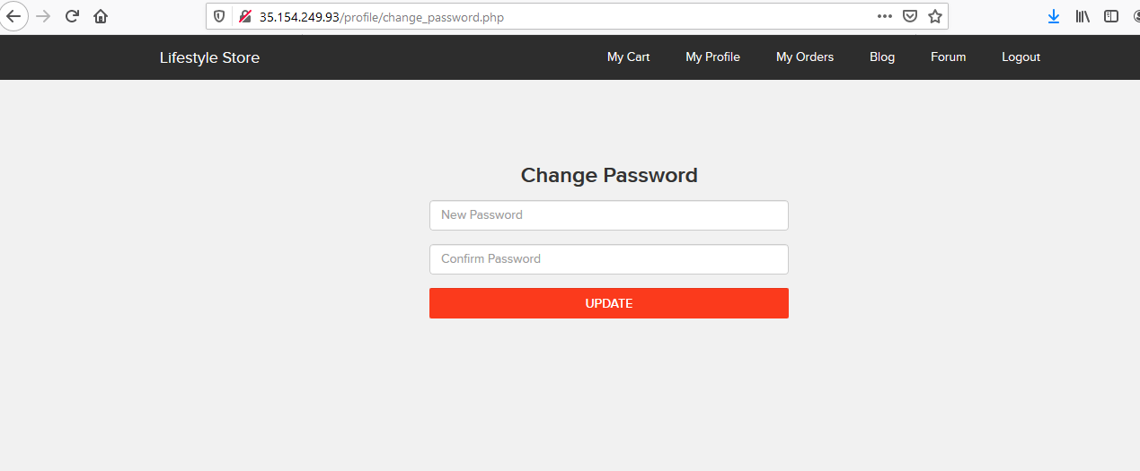
Observation:
We navigate to 'http://35.154.249.93/profile/change_password.php' after logging in to our account.

Slide 47
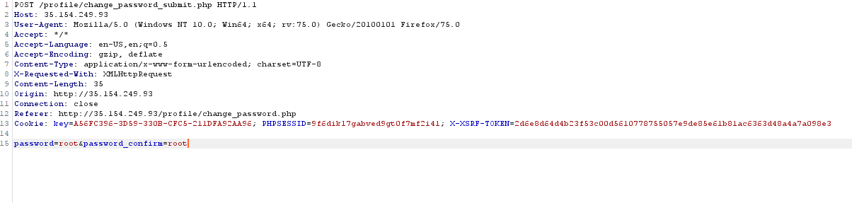
Observation:
To check that the update parameter checks the referrer or not ,we intercept it on burpsuite,and send it to repeater for verification.

Slide 48
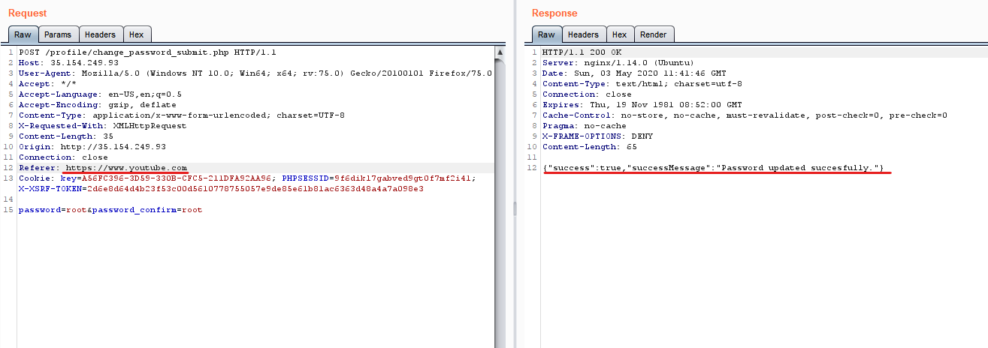
Proof Of Concept(PoC):
We change the referrer header in repeater and the password and forward the request,we see that it was successful in doing so,thus verifying CSRF.

Slide 49
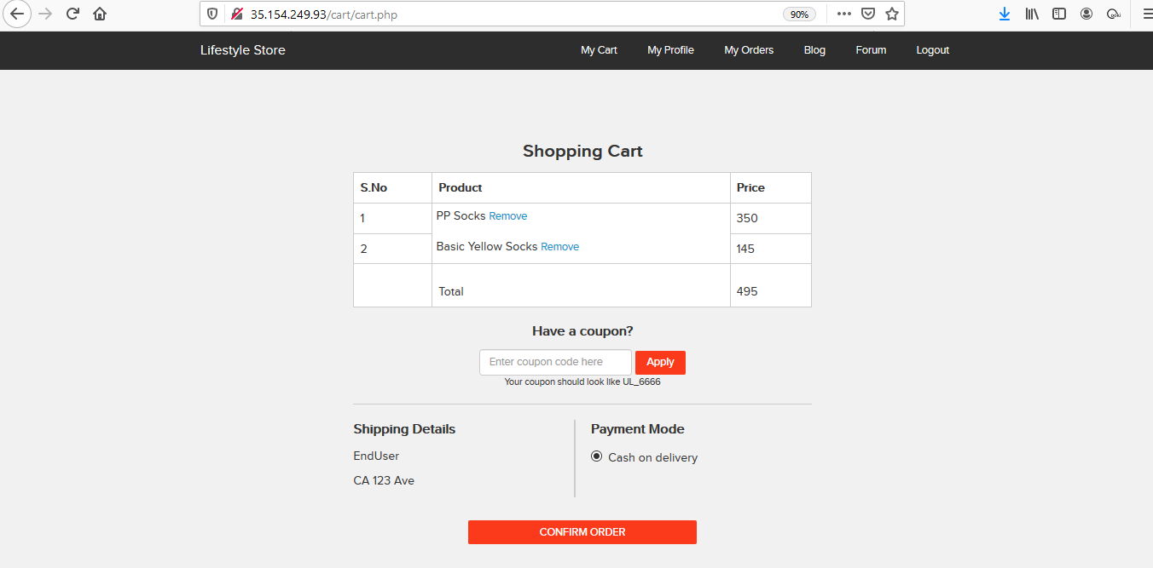
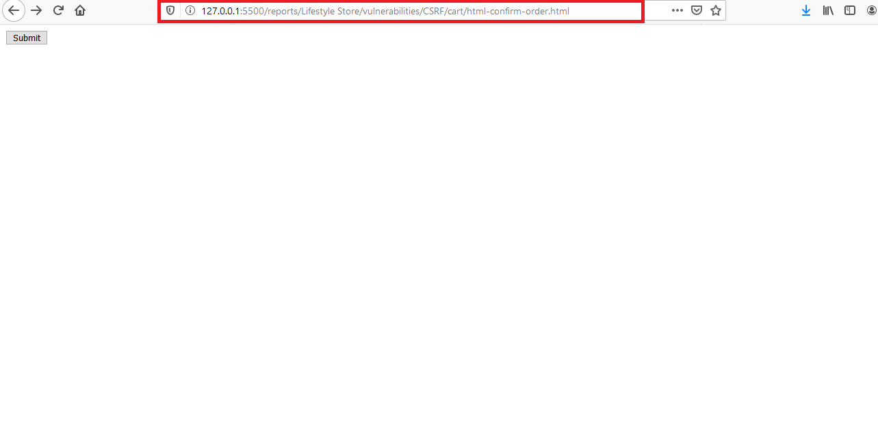
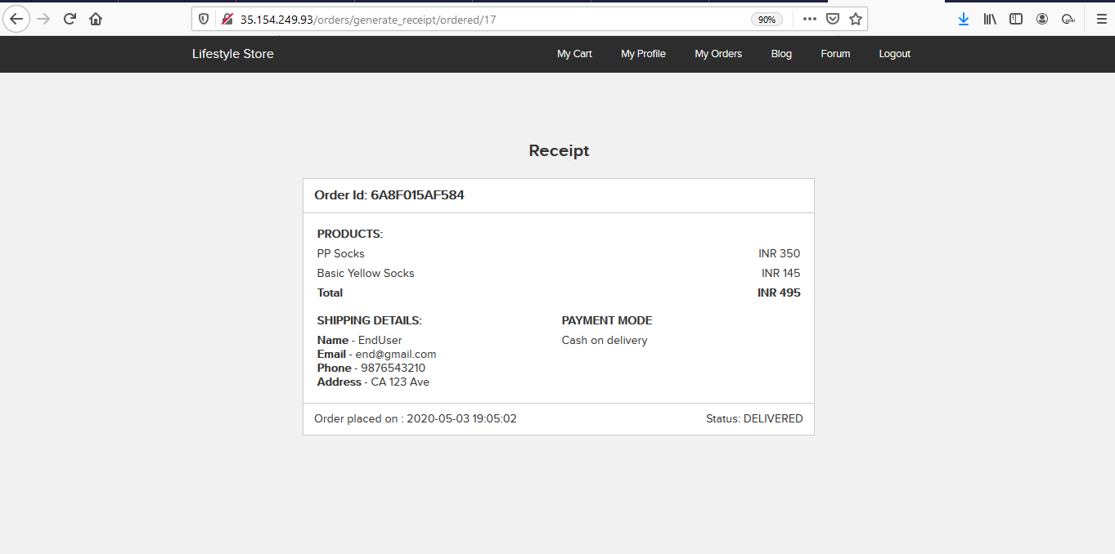
Proof Of Concept(PoC):
After creating an html page with img source from confirm button on page 'http://35.154.249.93/cart/cart.php',when we run it and reload out order page,we see our cart as empty and order placed.

Slide 50
Business Impact (High):
If the attacker is able to exploit this vulnerability,the he may be able to order many items which the user would cancel later when the sender will send it to him(as its cash on delivery),so unnecessary load of workers can increase incredibly.
Moreover,the attacker maybe able to change the user's password without his consent,which in itself is highly insecure.

Slide 51
Recommendation:
Ask the user his password (temporary like OTP or permanent like login password) at every critical action like while deleting account, making a transaction, changing the password etc.
Implement the concept of CSRF tokens which attach a unique hidden password to every user in every
Read the documentation related to the programming language and framework being used by your website
Check the referer before carrying out actions. This means that any action on x.com should check that the HTTP referrer is https://x.com/* and nothing else like https://x.com.hacker.com/*
References:
https://en.wikipedia.org/wiki/Cross-site_request_forgery#Example_and_characteristics
https://www.owasp.org/index.php/Cross-Site_Request_Forgery_(CSRF)https://www.owasp.org/index.php/Cross-Site_Request_Forgery_(CSRF)

Slide 52
8. Rate Limiting Flaws:
Rate Limiting Flaws(Severe) | Rate Limiting Flaws is found in the modules below:- Affected URL : http://13.233.207.87/reset_password/admin.php Affected Parameters : Username and password
 | Affected URL : http://13.233.207.87/login/admin.php Affected Parameters : Username and password
 | Affected URL: http://13.233.207.87/login/customer.php Affected Parameters: Username and Password

Slide 53
Rate Limiting Flaws(Severe) | Rate Limiting Flaws is found in the following modules too:- Affected URL : http://13.233.207.87/profile/17/edit/
 | Affected URL : http://13.233.207.87/login/seller.php Affected Parameters : Password
 | Affected URL: http://52.66.198.61/forum/index.php?u=/user/login Affected Parameters: Username and Password

Slide 54
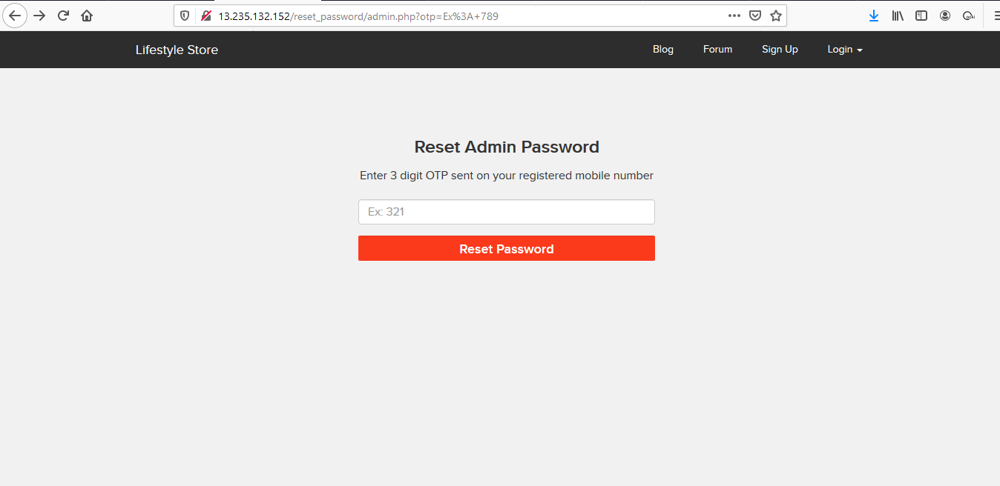
Observation Navigate to the URL http://13.233.207.87/reset_password/admin.php

Slide 55
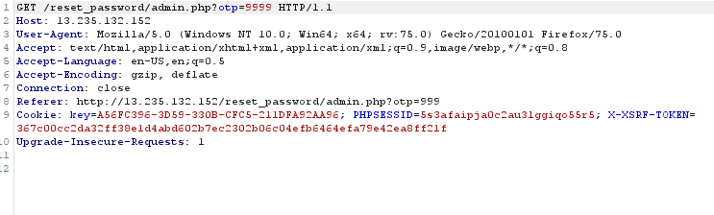
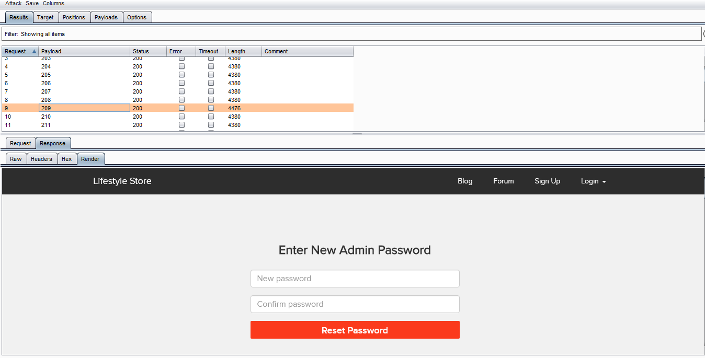
Proof Of Concept(PoC):
Click on reset password and intercept the request in burpsuite.send the request to the intruder. Try request with all possible combinations of 3 Digit.

Slide 56
Observation:
Similarly ,we were able to intercept and try multipe attacks on all the listed login and signup sites of the website and its blog too after intercepting them on burpsuite.

Slide 57
Business Impact(High):
If the attacker exploits this vulnerability,he may create a havoc on the webserver due to creation of a million accounts or a million attempts of login, which can further also lead to denial of service.
Furthermore, this lack of rate limitation configuration may also help the attacker by fetching him more time to bruteforce and fetch passwords of users or even the admin.

Slide 58
Recommendation:
The length of the password should be large and strong(unrelated).This makes bruteforcing impractical.
There should be at least two-step verification before creating an account.
Captcha can be used to protect from bruteforcing.
Number of attemps can be limited.
References:
https://www.cloudways.com/blog/what-is-brute-force-attack/
https://www.owasp.org/index.php/Blocking_Brute_Force_Attacks

Slide 59
9. Crypto Configuration Flaw
Crypto Configuration Flaw(Severe) | Cryto Configuration Flaws are found in the modules below:- Affected URL : http://13.233.207.87 (All the webpages ,blogs,forum)

Slide 60
Observation:
Clearly ,all the webpages use 'http' and not 'https' which is far less secure and not encryted.

Slide 61
Recommendation:
Business Impact(High):
Security is almost halved in http providing easy man-in-the-middle attack and others which makes it easy for attacker to go through the data transmitted over the internet/
Use https and not http as the protocol.
References:
https://www.owasp.org/index.php/Category:Cryptographic_Vulnerability
https://www.w3.org/Protocols/rfc2616/rfc2616-sec15.html

Slide 62
10. Weak Passwords:
Crypto Configuration Flaw(Severe) | Cryto Configuration Flaws are found in the modules below:- Affected URL : http://13.232.248.46/wondercms/loginURL http://13.232.248.46/login/seller.php

Slide 63
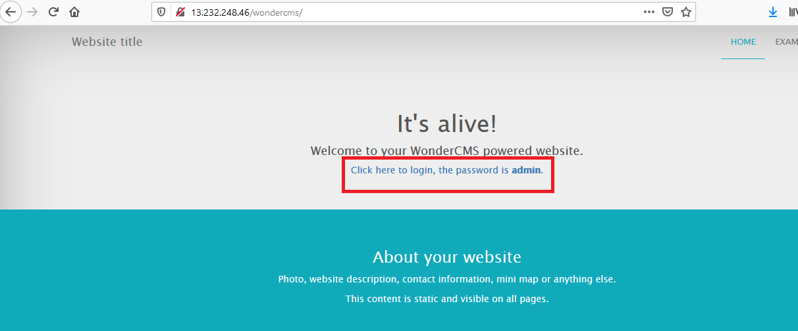
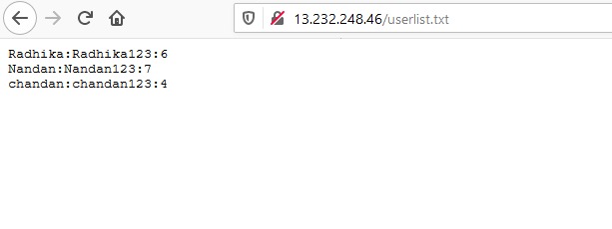
Observation:
The passwords of sellers and ,admin of blog,is very common and easily predictable.

Slide 64
Business Impact(High):
Easy,default and common passwords make it easy for attackers to gain access to their accounts illegal use of them and can harm the website to any extent after getting logged into privileged accounts.
Recommendation:
There should be password strength check at every creation of an account.
There must be a minimum of 8 characters long password with a mixture of numbers,alphanumerics,special characters,etc.
There should be no repetition of password,neither on change nor reset.
The password should not be stored on the web,rather should be hashed and stored.
References:
https://www.acunetix.com/blog/articles/weak-password-vulnerability-common-think/
https://www.owasp.org/index.php/Testing_for_Weak_password_policy_(OTG-AUTHN-007)

Slide 65
11. Open Redirection:
Open Redirection(Severe) | Open Redirection vulnerability are found in the module below:- Affected URL : http://35.154.249.93/products/details.php?p_id=5 Affected parameter : url (Brand Website)

Slide 66
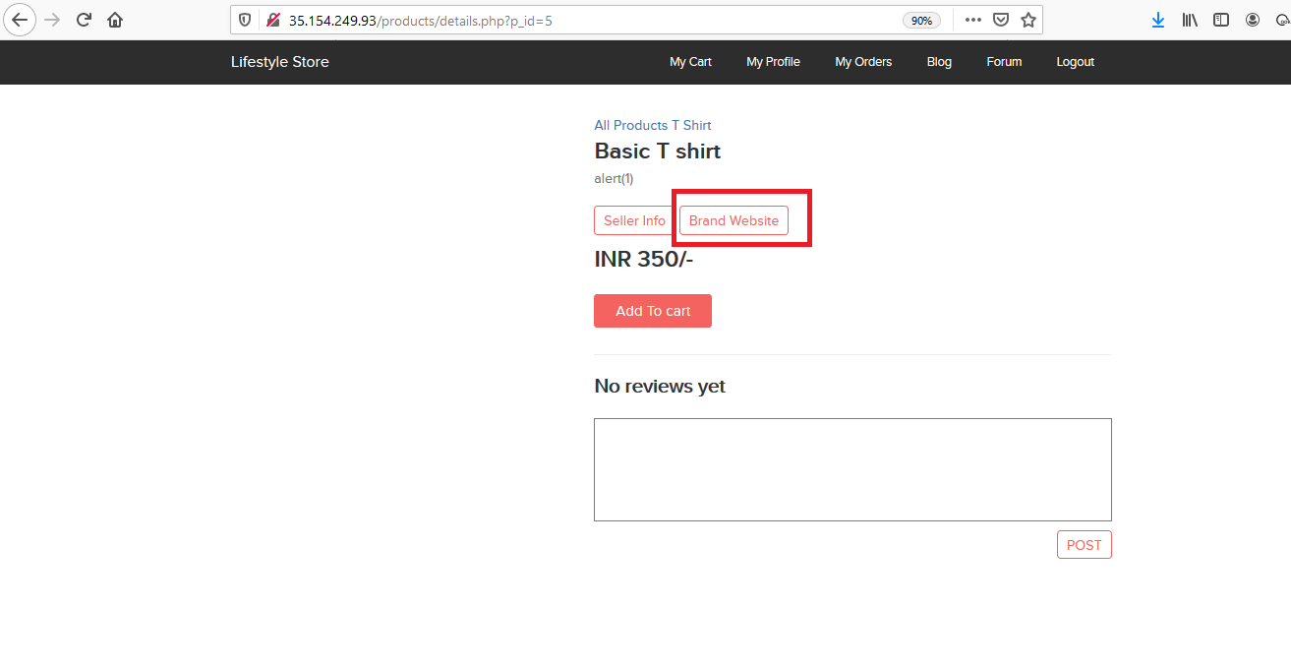
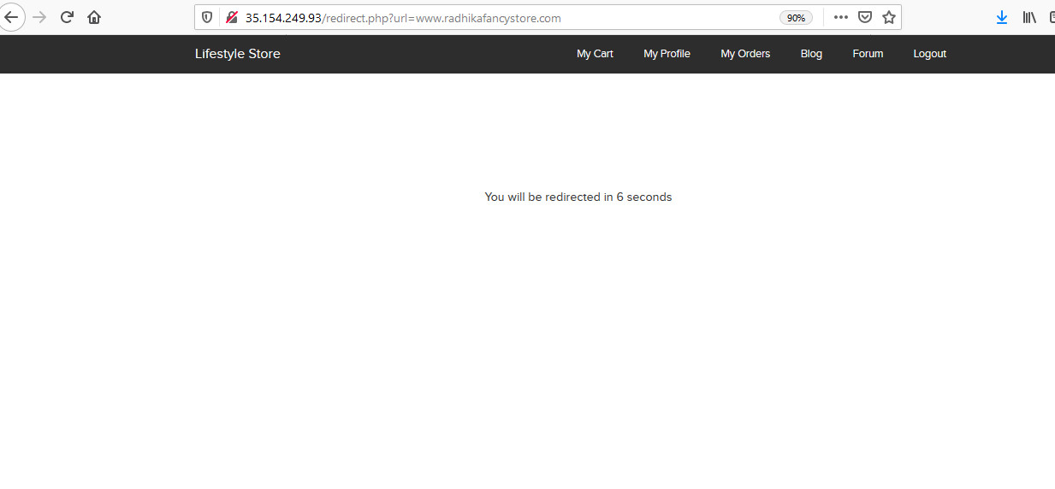
Observation:
When we view any product ,and click on “Brand Website” tab as shown,then we get redirected to it openly as GET parameter.

Slide 67
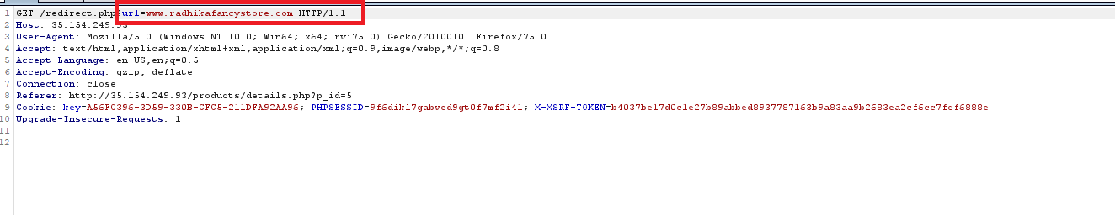
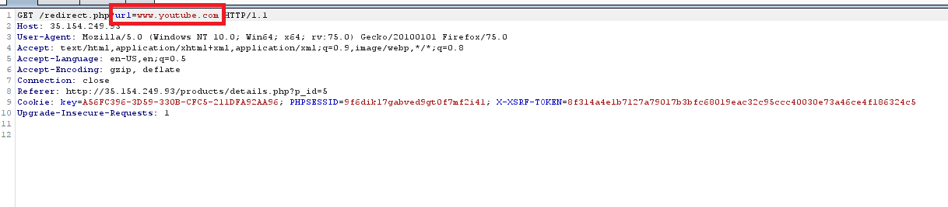
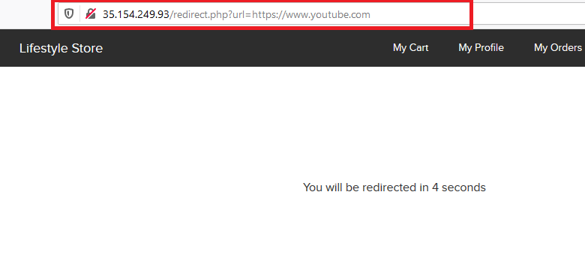
Proof Of Concept(PoC):
We can intercept the request in burp suite and change the redirect URL and click on forward.
1
2
3

Slide 68
Business Impact(High):
If the attacker changes the url to some malicious website looking similar to the given website, he can take the credentials and even credit card details on checkout from the user trust.

Slide 69
Recommendation:
If possible, applications should avoid incorporating user-controllable data into redirection targets. In many cases, this behavior can be avoided in two ways:
Remove the redirection function from the application, and replace links to it with direct links to the relevant target URLs.
Maintain a server-side list of all URLs that are permitted for redirection. Instead of passing the target URL as a parameter to the redirector, pass an index into this list.
If it is considered unavoidable for the redirection function to receive user-controllable input and incorporate this into the redirection target, one of the following measures should be used to minimize the risk of redirection attacks:
The application should use relative URLs in all of its redirects, and the redirection function should strictly validate that the URL received is a relative URL.
The application should use URLs relative to the web root for all of its redirects, and the redirection function should validate that the URL received starts with a slash character. It should then prepend http://yourdomainname.com to the URL before issuing the redirect.
The application should use absolute URLs for all of its redirects, and the redirection function should verify that the user-supplied URL begins with http://yourdomainname.com/ before issuing the redirect.

Slide 70
References:
https://portswigger.net/kb/issues/00500100_open-redirection-reflected
https://www.owasp.org/index.php/Testing_for_Client_Side_URL_Redirect_(OTG-CLIENT-004)

Slide 71
12. Brute Force Exploitation:
Brute Force Exploitation(Severe) | Brute Force vulnerability are found in the module below:- Affected URL : http://35.154.249.93/cart/cart.php Affected parameter : coupon (POST parameter)
 | Affected URL : http://35.154.147.149/login/seller.php Affected parameter : username(POST parameter) password(POST parameter)

Slide 72
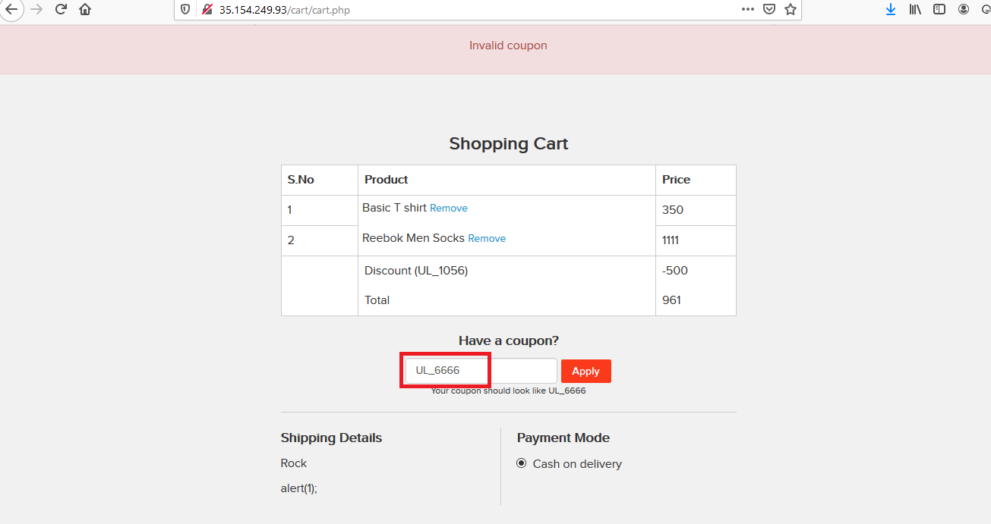
Observation:
Login with the customer username and password, Add item to cart, Navigate to cart.

Slide 73
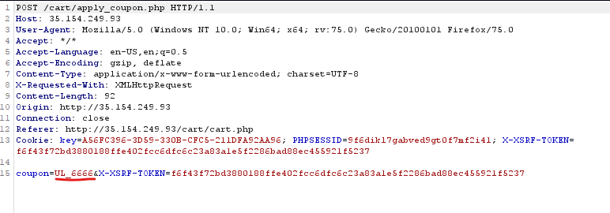
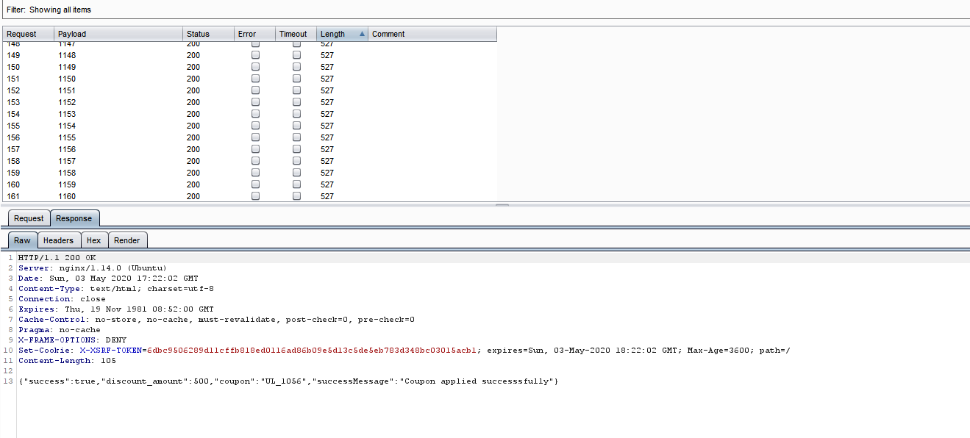
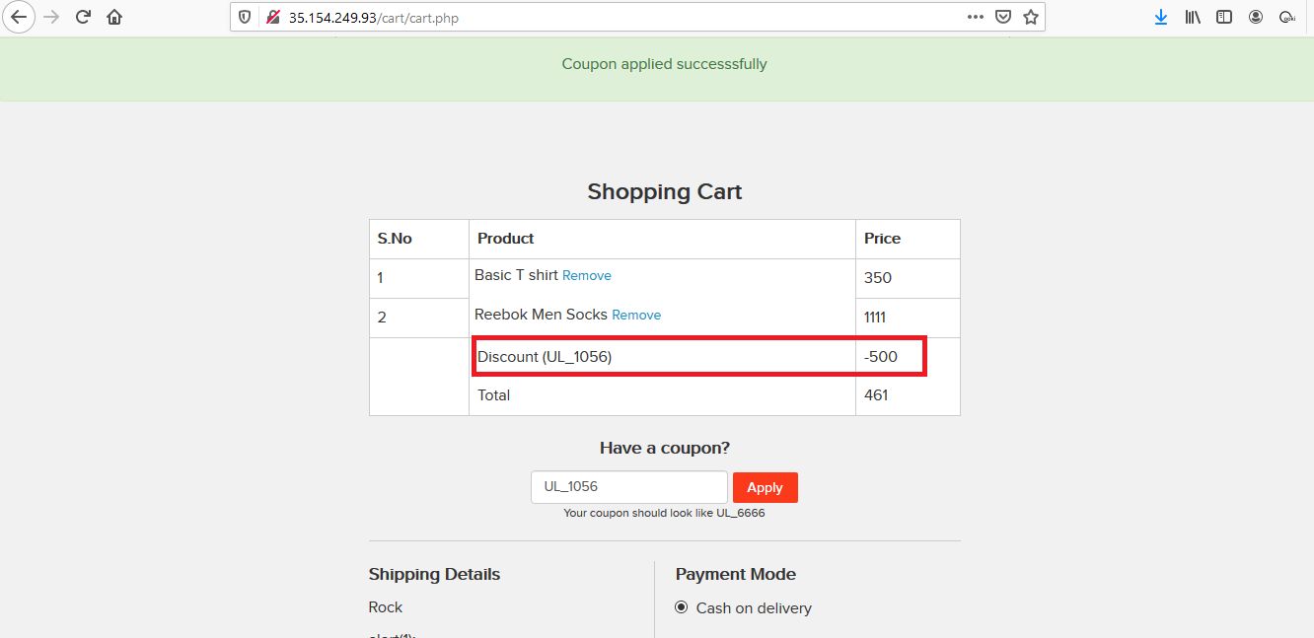
Proof Of Concept(PoC):
Click on the apply coupon and intercept the request in burp suite
1
2
3

Slide 74
Business Impact(High):
Financial status of the business can be affected if the attacker keep on using coupon_code of the product.

Slide 75
Recommendation:
Utilizing or requiring strong passwords
Allowing a limited number of login attempts
Employing the use of CAPTCHAs
Setting time delays between attempts
Asking security questions
Enabling two-factor authentication
Using multiple login URLs
Tricking the attack software

Slide 76
References:
https://blog.sucuri.net/2013/04/brute-force-attacks-and-their-consequences.html
https://www.comparitech.com/blog/information-security/brute-force-attack/

Slide 77
13. Components with known Vulnerabilities:
Components with known vulnerabilities(Severe) | Brute Force vulnerability are found in the module below:- Affected URL : http://13.232.248.46/wondercms/loginURL

Slide 78
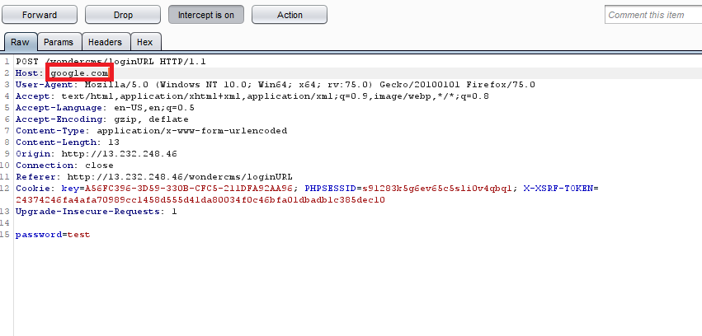
Observation:
Go to the login page of the blog section, and Intercept the request in burpsuite try to Change the hostname to 'www.google.com' and Click on proceed the page get redirected.

Slide 79
Business Impact(High):
Modification of some system files or information is possible, but the attacker does not have control over what can be modified, or the scope of what the attacker can affect is limited

Slide 80
Recommendation:
To Mitigate host header injections allows only a whitelist of allowed hostnames.
Upgrade to the latest version of Affected Software/theme/plugin/OS which means latest version number.
References: CVE ID : CVE-2017-14523
https://www.cvedetails.com/cve/CVE-2017-14523/
https://www.exploit-db.com/exploits/43964
https://securitywarrior9.blogspot.in/2018/01/host-header-injection-in-wonder-cms.html

Slide 81
14. Directory Listing
Directory Listing (Moderate) | Below mentioned parameters are vulnerable to Directory Listing Affected URL : http://15.206.67.102/static/images/

Slide 82
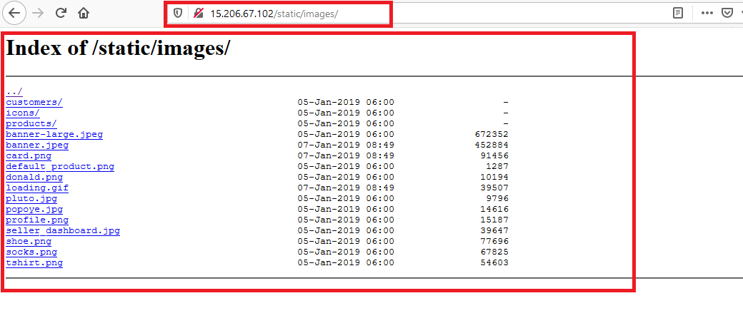
Observation:
1)Navigate to http://15.206.67.102/static/images/
2)Complete listing of directory is shown containing names of files and folders of the website

Slide 83
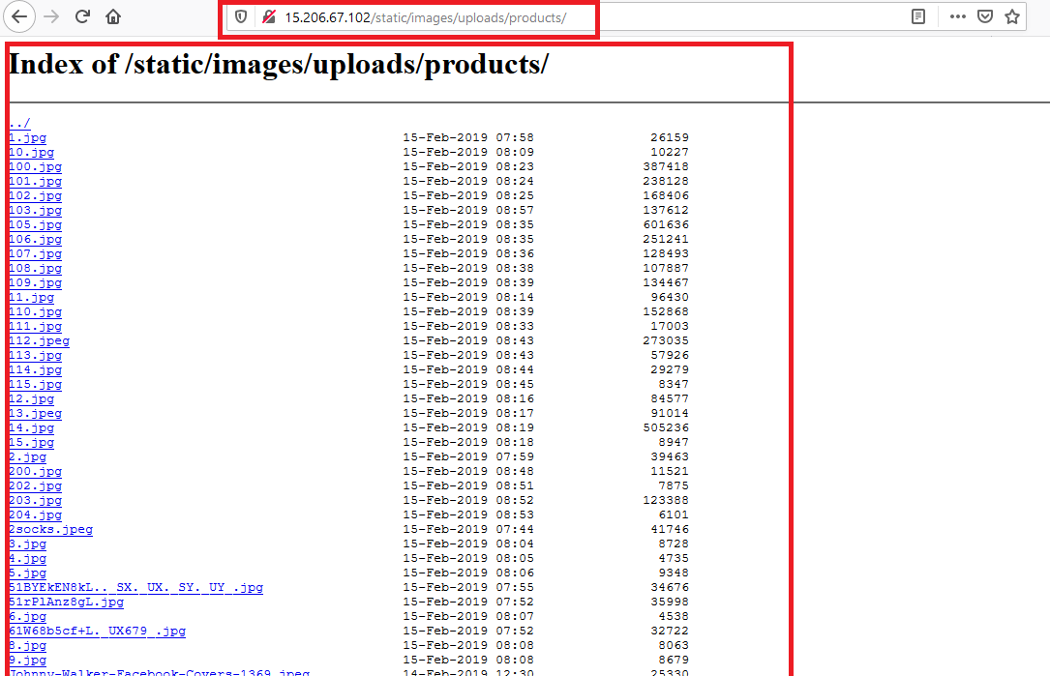
Observation:
Navigate to http://15.206.67.102/static/images/uploads/products/
This gives the complete list of product images.

Slide 84
Business Impact – Moderate
Although this vulnerability does not have a direct impact to users or the server, though it can aid the attacker with information about the server and the users
Also, attacker can simply download the backups and images and view them.

Slide 85
Recommendation:
Take the following precautions:
Disable Directory Listing
Put an index.html in all folders with default message
References:
https://cwe.mitre.org/data/definitions/548.html
https://www.netsparker.com/blog/web-security/disable-directory-listing-web-servers/

Slide 86
15. IDOR
IDOR (Moderate) | Below mentioned parameters are vulnerable to IDOR (Displaying Customer Details) Affected URL : http://13.233.207.87/profile/16/edit/ http://13.233.207.87/orders/orders.php?customer=17 Affected Parameters : user_id(POST parameter) customer(GET parameter) Payload: Changing user_id from 16 to 15 in the url itself

Slide 87
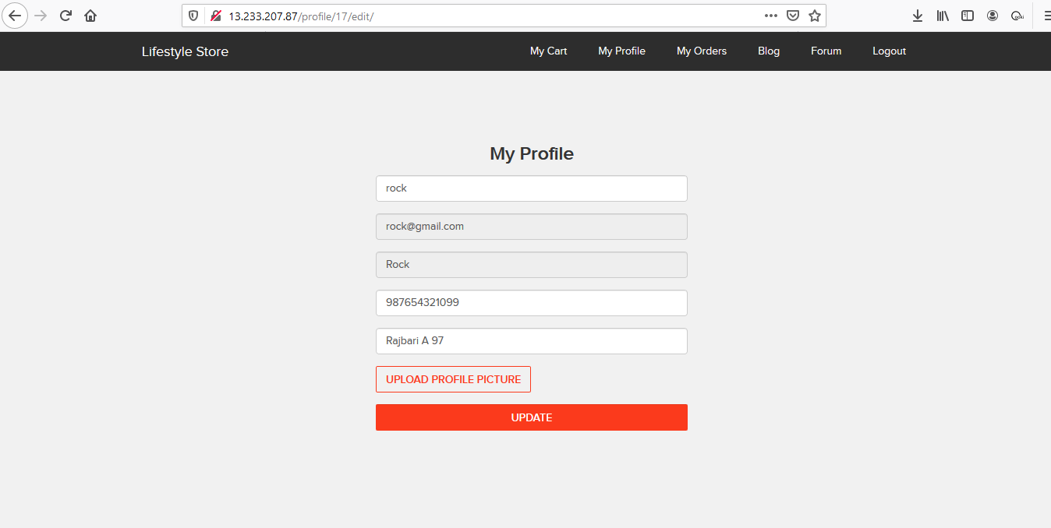
Observation:
User detail of user id 17 is displaying

Slide 88
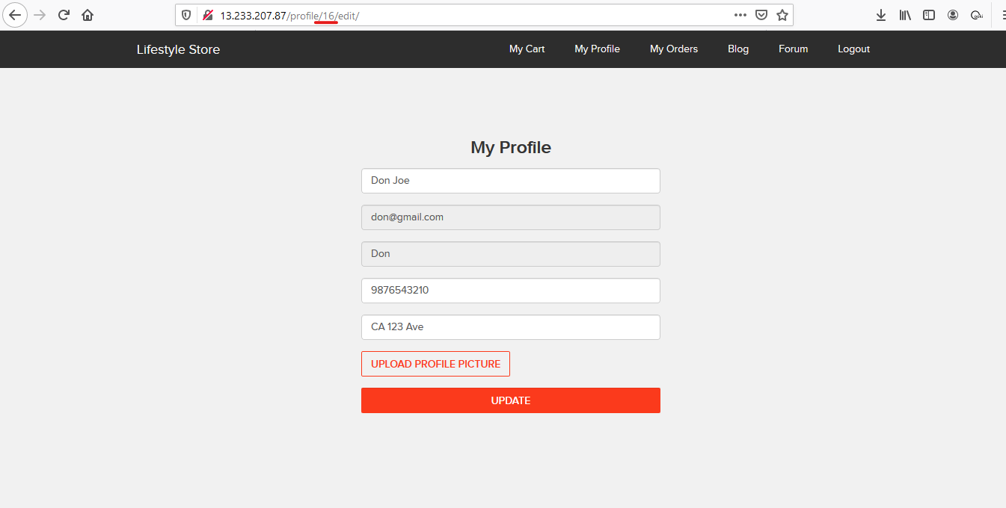
Proof Of Concept(PoC):
Gain information of another user by Change the URL parameter from "http://13.233.207.87/profile/17/edit/" to "http://13.233.207.87/profile/16/edit/".

Slide 89
Business Impact(High):
Taking the advantage of this vulnerability,if the attacker can get these sensitive data of multiple users,it would be become one step easier for them to login to their accout after getting their username.
The revealed data includes(name,username,email,address,phone number,etc.) are sufficient for performing a full fledge social engineering attack on the user.

Slide 90
Recommendation:
Take the following precautions:
Implement proper authentication and authorisation checks to make sure that the user has permission to the data he/she is requesting
Use proper ratelimiting checks on the number of request comes from a single user in a small amount of time
Make sure each user can only see his/her data only.
References:
https://www.owasp.org/index.php/Insecure_Configuration_Management
https://www.owasp.org/index.php/Top_10_2013-A4-Insecure_Direct_Object_References

Slide 91
16. PII Leakage:
PII Leakage (Moderate) | Below mentioned URL gives the unrequired details about the seller and user: Affected URL : http://15.206.67.102/products/details.php?p_id=28 http://13.232.248.46/login/customer.php

Slide 92
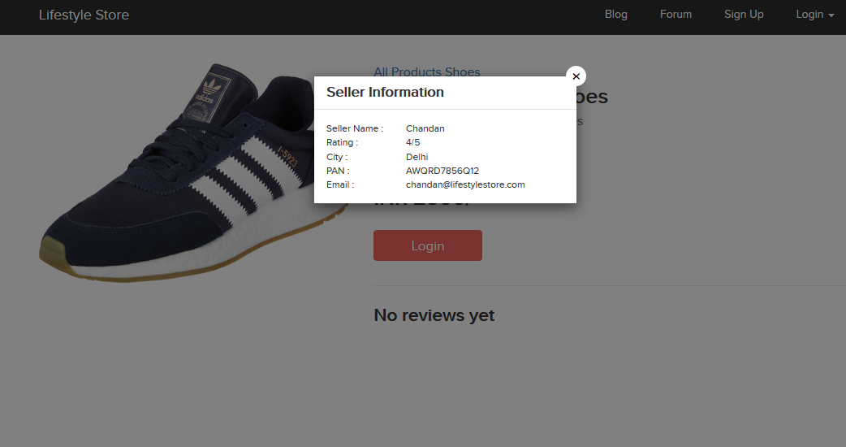
Observation:
When we click on the “Seller Info” option,we get the details of the seller ,even those which are not required like the pan card number,etc.

Slide 93
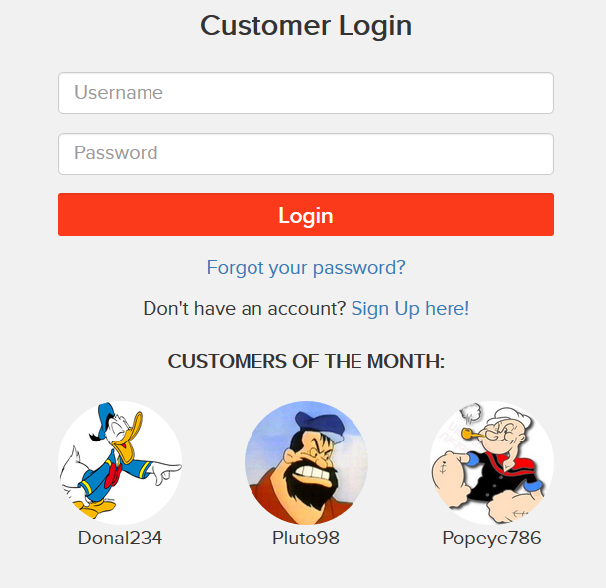
Observation:
You can see Customer usernames are displayed publicly.

Slide 94
Business Impact(Moderate):
There is no direct business impact in this case ,but this amount of information can definitely lead to social engineering attacks on the seller and can indirectly harm the business.

Slide 95
Recommendation:
Only name and email is sufficient as far as the query or help is concerned.
Username and profile pic of other user should not be display

Slide 96
17. Client Side Filter Bypass
Client Side Filter Bypass (Low) | Below mentioned urls have improper server side filter Affected URL : http://13.233.108.21/profile/16/edit/ Affected parameter: Contact Number
 | Affected URL : http://13.233.207.87/forum/index.php?u=/user/register Affected parameter: Email address
 | Affected URL : http://13.233.207.87/reset_password/customer.php Affected parameter: Password

Slide 97
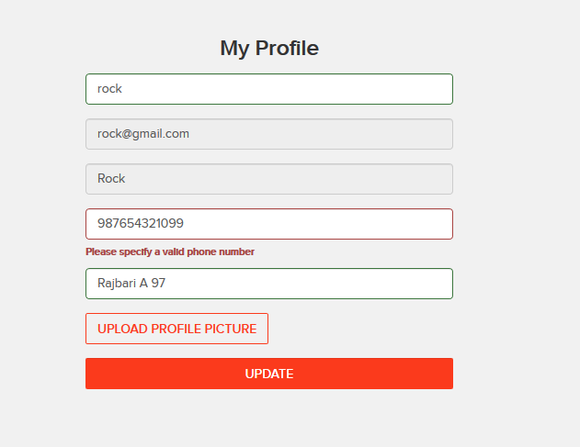
Observation:
After logging in as customer,when we try to edit our phone number to some invalid one ,the error is as shown.

Slide 98
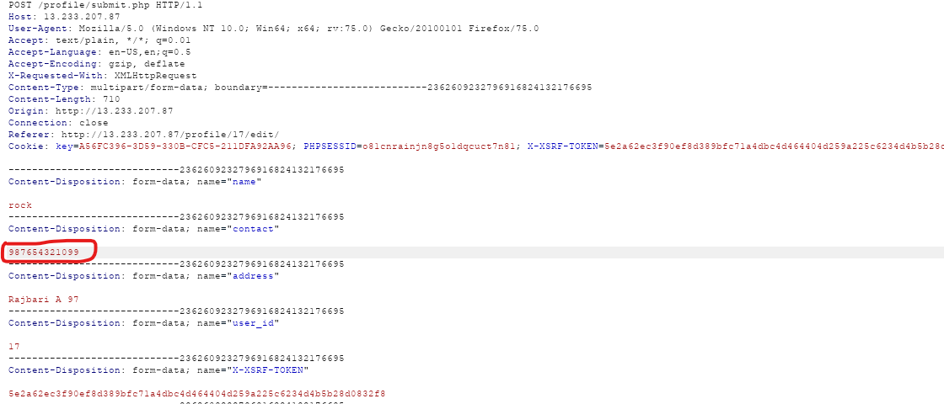
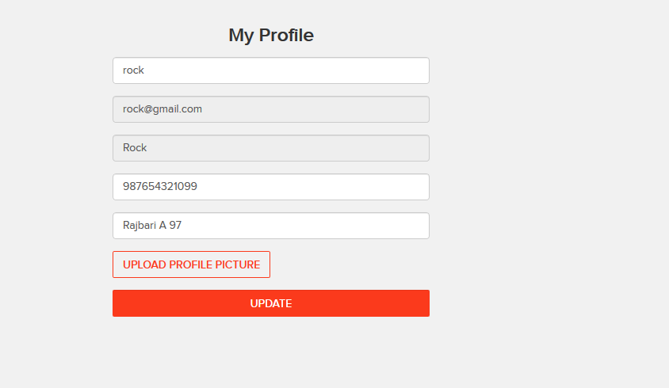
Proof Of Concept(PoC):
But when we give a valid phone number on the client side,but intercept it through burpsuite and again give invalid number,it gets accepted.

Slide 99
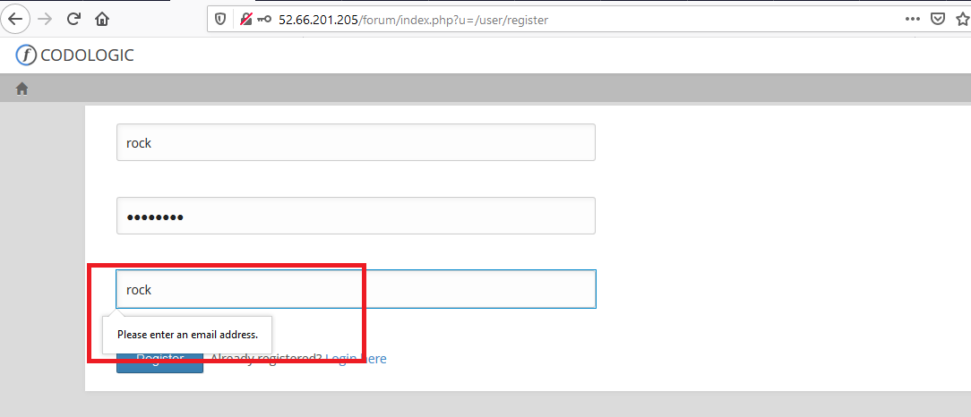
Observation:
Navigate to registration forum page “http://13.233.207.87/forum/index.php?u=/user/register” and try to register a user with invalid email id, it gives an error.

Slide 100
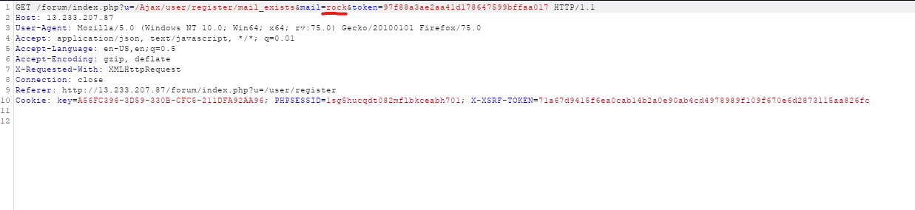
Proof Of Concept(PoC):
Give a valid email id and intercept the request using burp suite then change the email id, and click on proceed, it get register successfully.

Slide 101
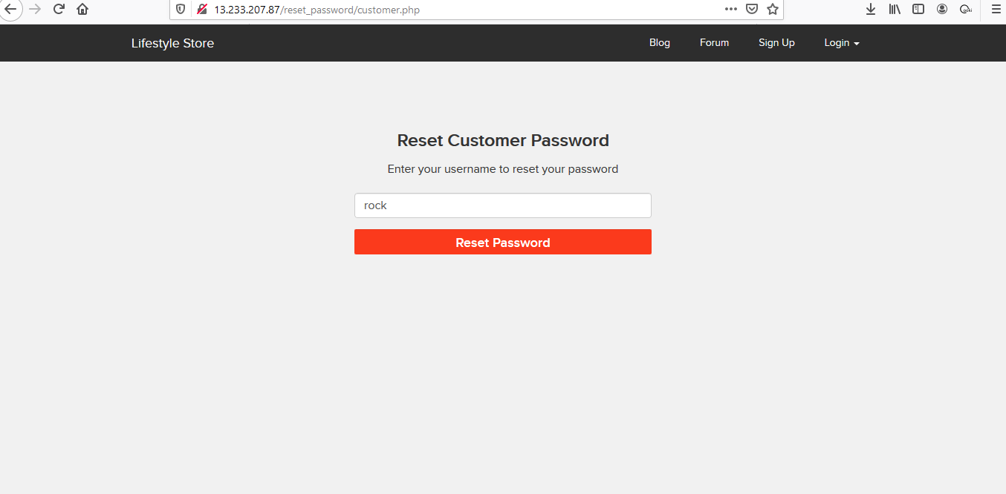

Observation:
Navigate to customer password reset page “http://13.233.207.87/reset_password/customer.php” and try to give a already register username , email id of the register user is been populated in the input field click on send.

Slide 102


Proof Of Concept(PoC):
AFter click on send a html page get open, click on 'click here' link, a page will open for providing new password for the user.

Slide 103
Business Impact(Low):
The data provided by the user ,if incorrect, is not a very big issue but still must be checked for proper validatory information.
Recommendation:
Implement all critical checks on server side code only
Client-side checks must be treated as decoratives only
All business logic must be implemented and checked on the server code. This includes user input, the flow of applications and even the URL/Modules a user is supposed to access or not

Slide 104
References:
http://projects.webappsec.org/w/page/13246933/Improper%20Input%20Handling
https://www.owasp.org/index.php/Unvalidated_Input

Slide 105
18. Descriptive Messages:
Descriptive Messages (Low) | Below mentioned urls have default error displaying on fuzzing: Affected URL : http://35.154.118.58/?includelang=lang/en.php Payload en1.php
 | Affected URL: http://35.154.118.58/search/search.php Parameter: q(GET) Payload q='

Slide 106

Observation:
The default error with the path is displayed as:

Slide 107

Proof Of Concept(PoC):
When we give ' in the search option of the home page,we get the error as:

Slide 108
Business Impact(Moderate):
Although this vulnerability does not have a direct impact to users or the
server, though it can help the attacker in mapping the server architecture
and plan further attacks on the server.
Recommendation:
Do not display the default error messages because it not tells about the server but also sometimes about the location.So,whenever there is an error ,send it to the same page or throw some manually written error.

Slide 109
References:
https://www.owasp.org/index.php/Improper_Error_Handling

Slide 110
19. Descriptive Pages:
Descriptive Pages (Low) | Below mentioned urls have improper server side filter Affected URL : http://35.154.118.58 Default pages available: robots.txt sever-status phpinfo.php userlist.txt

Slide 111

Proof Of Concept(PoC):
When we entered robots.txt at the end of the index page URL,we got:

Slide 112

Proof Of Concept(PoC):
When we entered phpinfo.php at the end ,we got:

Slide 113

Proof Of Concept(PoC):
When we entered server-info at the end of index URL:

Slide 114
Proof Of Concept(PoC):
When we typed and entered userlist.txt at the end:

Slide 115
Business Impact – Moderate
Although this vulnerability does not have a direct impact to users or the server, though it can help the attacker in mapping the server architecture and plan further attacks on the server
Recommendation
Take the following precautions:
Disable all default pages and folders including server-status and server-info
References:
https://vuldb.com/?id.88482
https://httpd.apache.org/docs/current/mod/mod_status.html
https://www.beyondsecurity.com/scan_pentest_network_vulnerabilities_apache_http_server_httponly_cookie_information_disclosure

Slide 116
THANK YOU
For any further clarifications/patch assistance, please contact: 8011806053

